Slide 1






MASTER THESIS DISCUSSION
Part 1
19/06/2024
12:15

Slide 2



INTRODUCTION
Studying full time master in computer science
BACKGROUND
Prior experience in object detection and machine learning practices
PROBLEM
Participation in related projects: BlendEd Mobility by Erasmus+, Data Science Seminar by ISG chair; Uni Siegen, and at work place (Technologie-Institut für Metall und Engineering GmbH)
MAIN TASK
NEXT STEP

Slide 3
INTRODUCTION
BACKGROUND
Company: Technologie-Institut für Metall und Engineering GmbH
Application-oriented research organisation: Testing and application development in simulation, welding and joining techniques or altogether engineering
PROBLEM
Based in: Wissen – Sieg (40 Min drive from Siegen)
MAIN TASK
Approx Employees: ≤20
NEXT STEP
Presentation by Ketut Susilo | Business Marketing | 2029 | Borcelle University

Slide 4
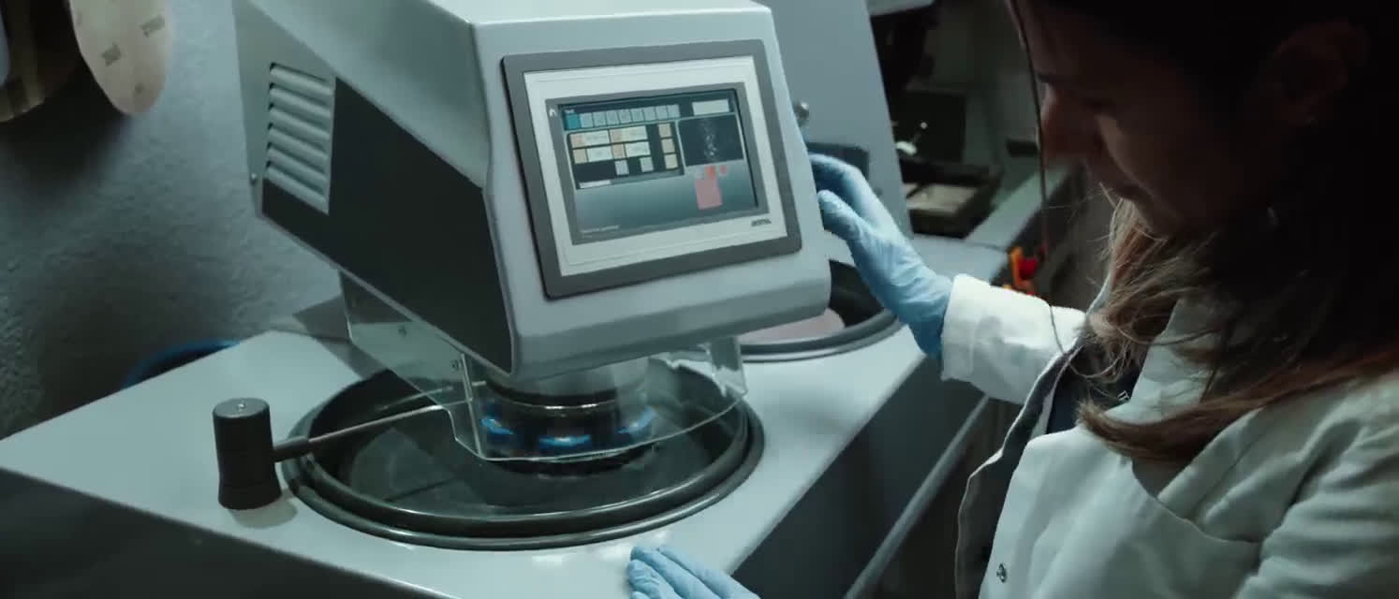
INTRODUCTION
BACKGROUND
PROBLEM
MAIN TASK
NEXT STEP
Presentation by Ketut Susilo | Business Marketing | 2029 | Borcelle University

Slide 5
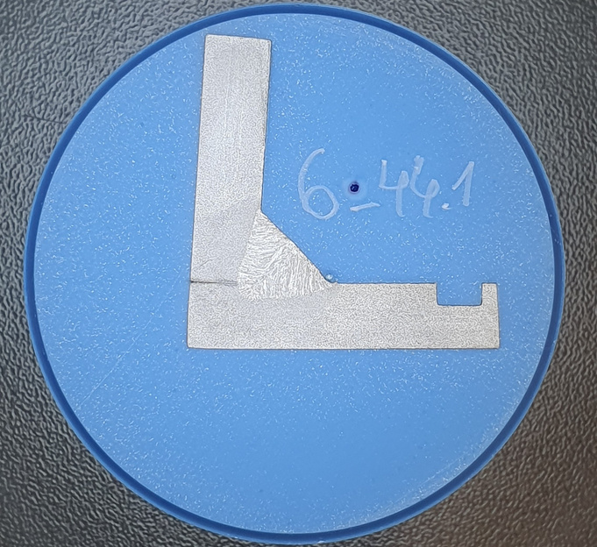
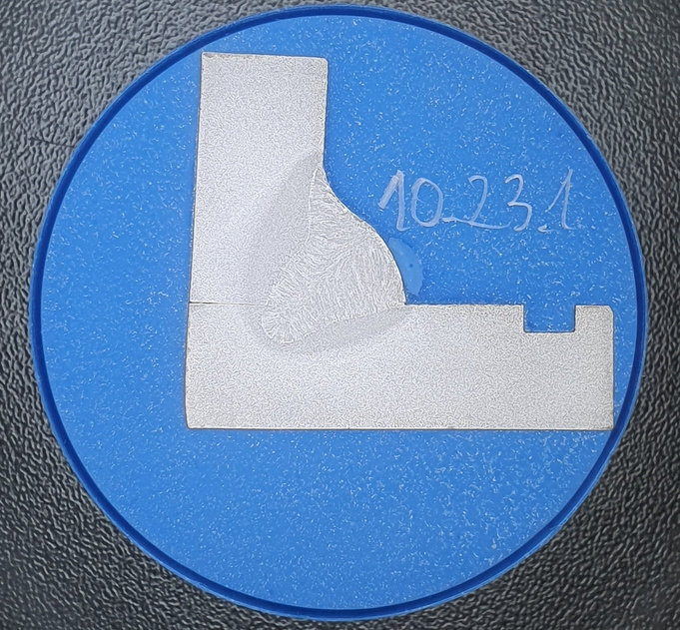
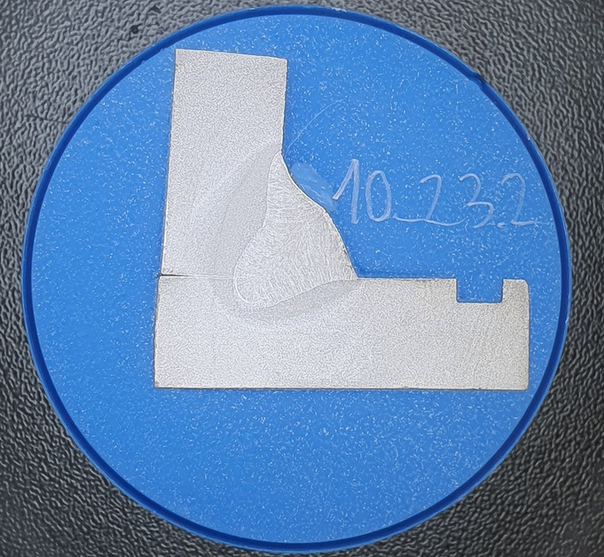
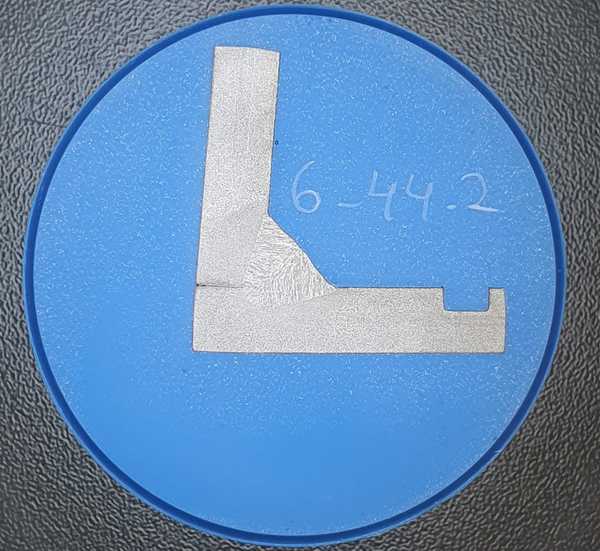
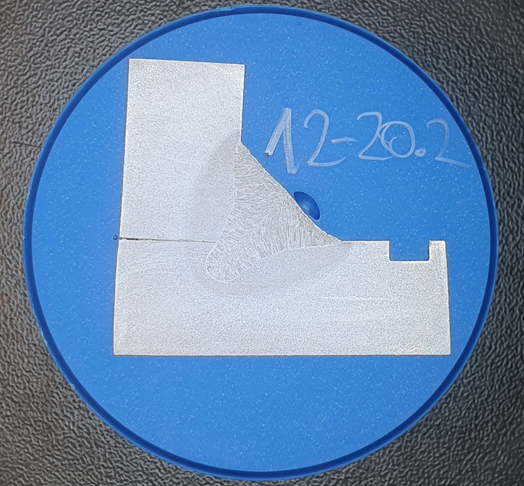
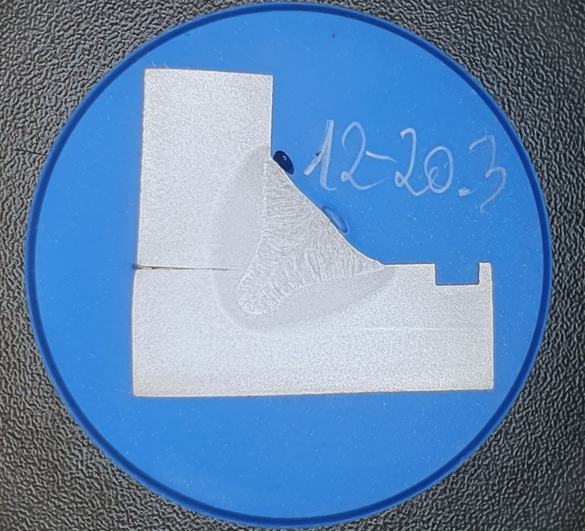
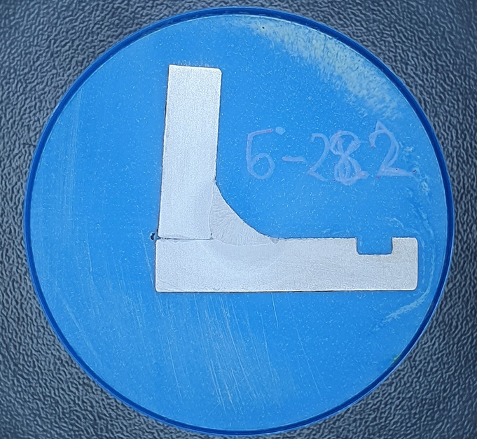
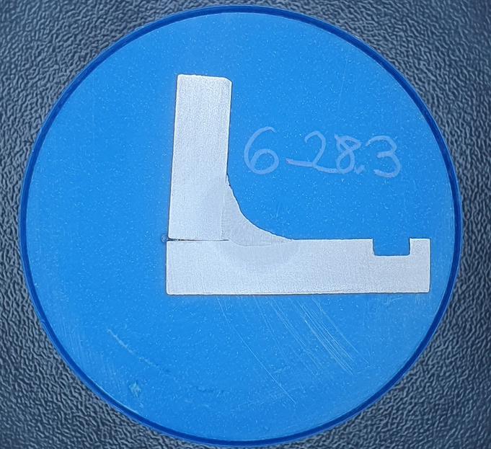
INTRODUCTION
Overview of the dataset
BACKGROUND
PROBLEM
MAIN TASK
NEXT STEP
Presentation by Ketut Susilo | Business Marketing | 2029 | Borcelle University

Slide 6
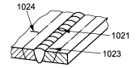
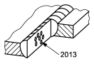
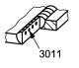


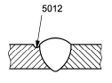
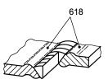
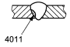
INTRODUCTION
DIN ISO 6520-1 Deutsche Norm
Geometrischen Unregelmäßigkeiten an metallischen Werkstoffen
BACKGROUND
Cracks
Cavaties
Solid Inclusion
PROBLEM
MAIN TASK
Lack of Fusion
Imperfect shape
Miscellaneous: Swelling
NEXT STEP
Presentation by Ketut Susilo | Business Marketing | 2029 | Borcelle University

Slide 7













INTRODUCTION
BACKGROUND
Producing errors with GAN and other resources
PROBLEM
Object detection Pipeline
Welding errors Knowledege
MAIN TASK
NEXT STEP
Web scrapping
Algorithm slection

Slide 8
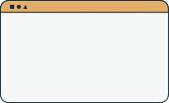
INTRODUCTION
BACKGROUND
Frequency of meetings? Ex: two, all three.
Evaluation criteria for perfect work?
Thesis registration after approx. 60 days
Disclaimer: Might ask strange questions, kindly bear
PROBLEM
MAIN TASK
NEXT STEP

Slide 9



THANK YOU

